Slide 1
Brain Tumor Classification Using Deep Learning
A Streamlit-based AI Tool for Medical Image Diagnosis
By – Aryan Sengar

Slide 2
Problem Overview:
Brain tumors are life-threatening medical conditions that require early and accurate diagnosis. Currently, radiologists rely on manual inspection of MRI and CT scans, which is:
Time-consuming
Prone to human error
Inconsistent across professionals
Difficult to scale for large patient volumes
Problem to Solve:
How can we leverage Artificial Intelligence to assist clinicians by providing fast, reliable, and explainable brain tumor detection?

Slide 3
Proposed Solution:
We developed an AI-powered Brain Tumor Classification System using Deep Learning (CNNs) that classifies brain MRI and CT images as:
Healthy
Tumor
Key Highlights:
Real-time image classification
Prediction confidence and visualization
Batch image processing
Auto-generated diagnostic PDF reports
Simple and intuitive Streamlit-based web interface

Slide 4
How is this solution different?
Combines deep learning + visualization + reporting in one platform
Provides confidence scores instead of black-box predictions
Supports batch classification via ZIP upload
Generates downloadable medical-style PDF reports
How does it solve the problem?
Reduces diagnosis time
Minimizes human error
Assists clinicians with consistent predictions
Makes AI accessible to non-technical medical users

Slide 5
Core Features:
Upload MRI / CT brain scans
CNN-based tumor classification
Confidence score & probability distribution
Original vs preprocessed image comparison
Batch prediction using ZIP files
CSV export of batch results
Automated PDF diagnostic report generation
Prediction history dashboard

Slide 6
Google Technologies:
Google TensorFlow
Used for building, training, and deploying the CNN model
Supporting Technologies:
Python
Streamlit
OpenCV
NumPy, Pandas
Matplotlib
FPDF

Slide 7
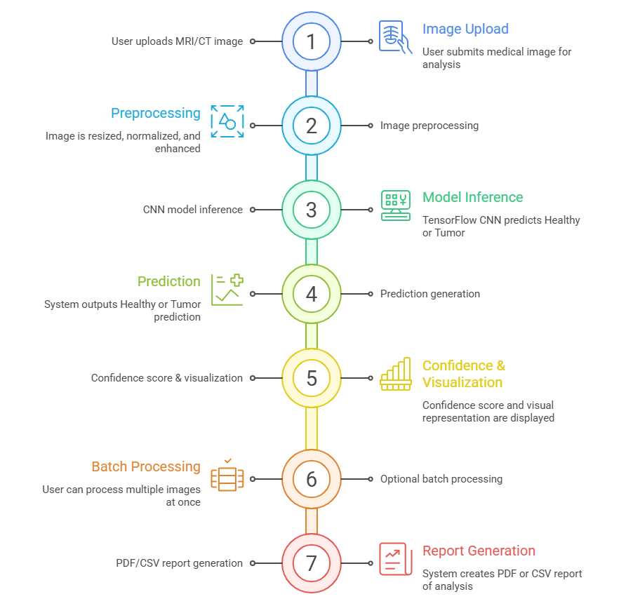
Process Flow:

Slide 8
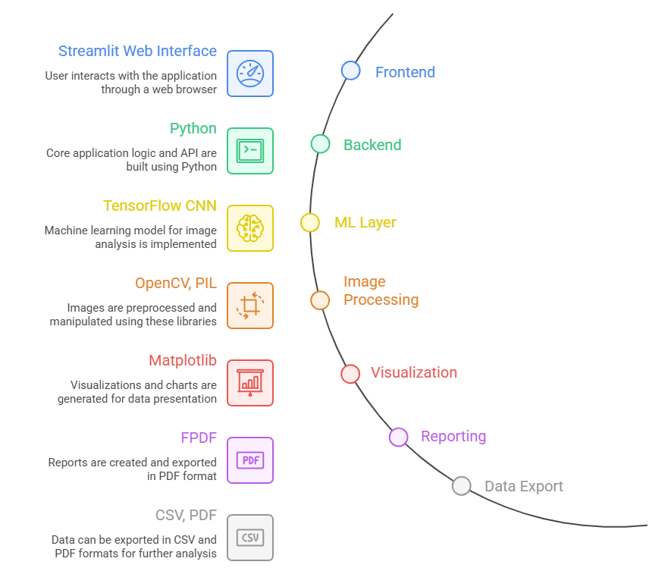
System Architecture:

Slide 9
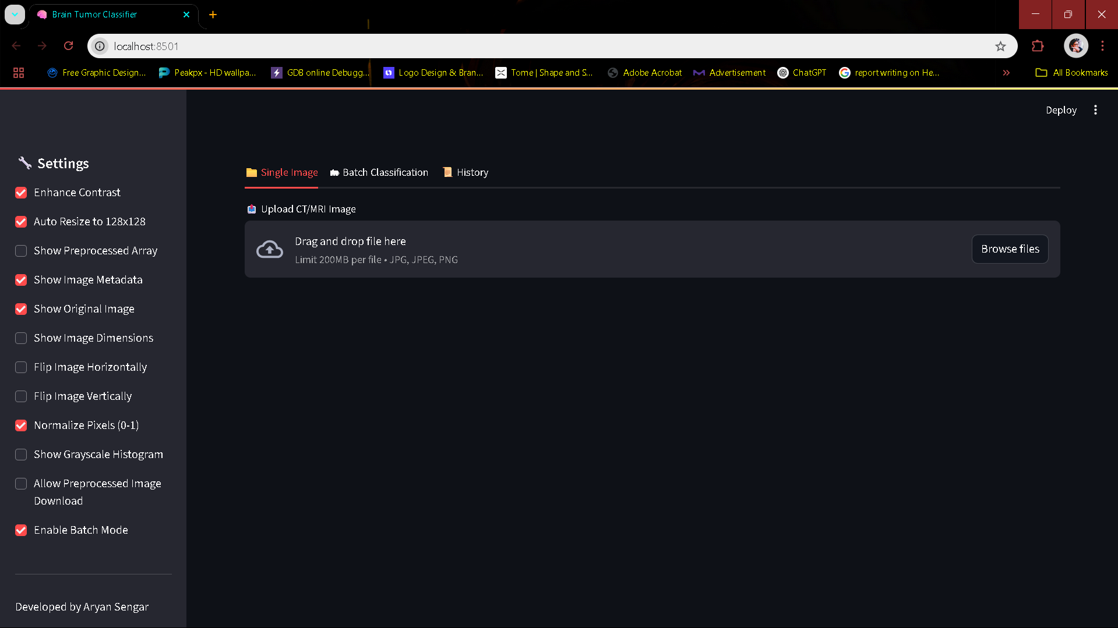
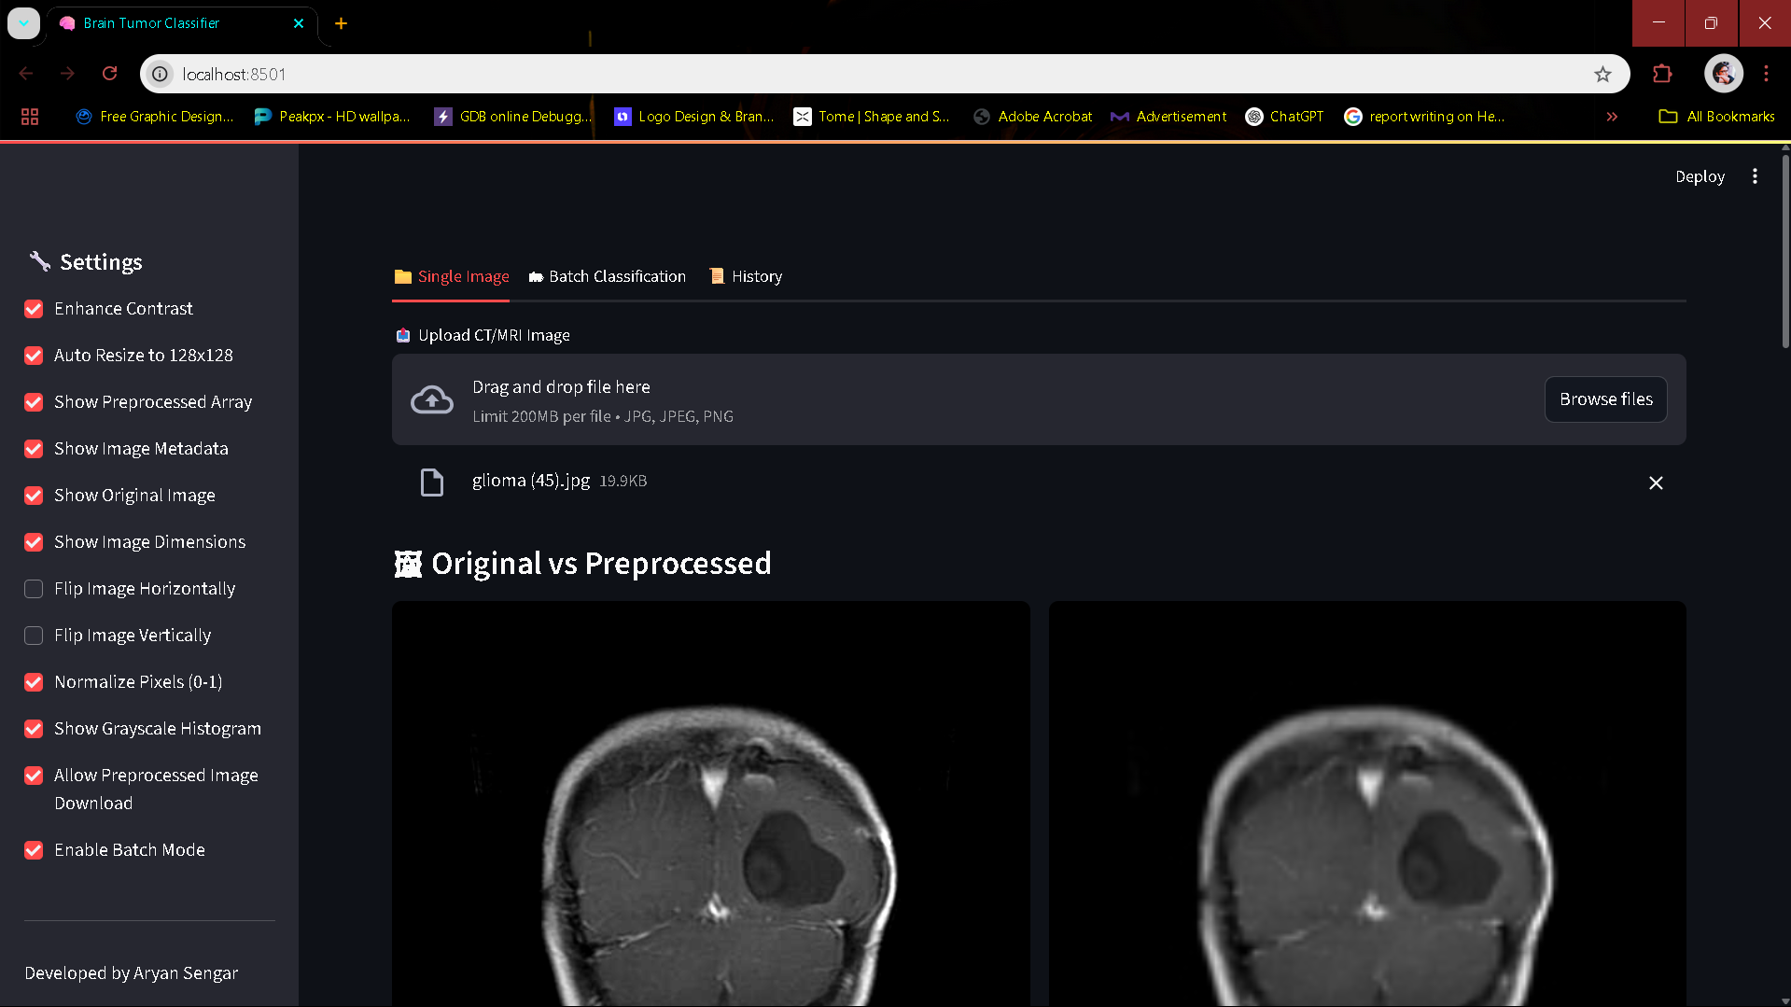
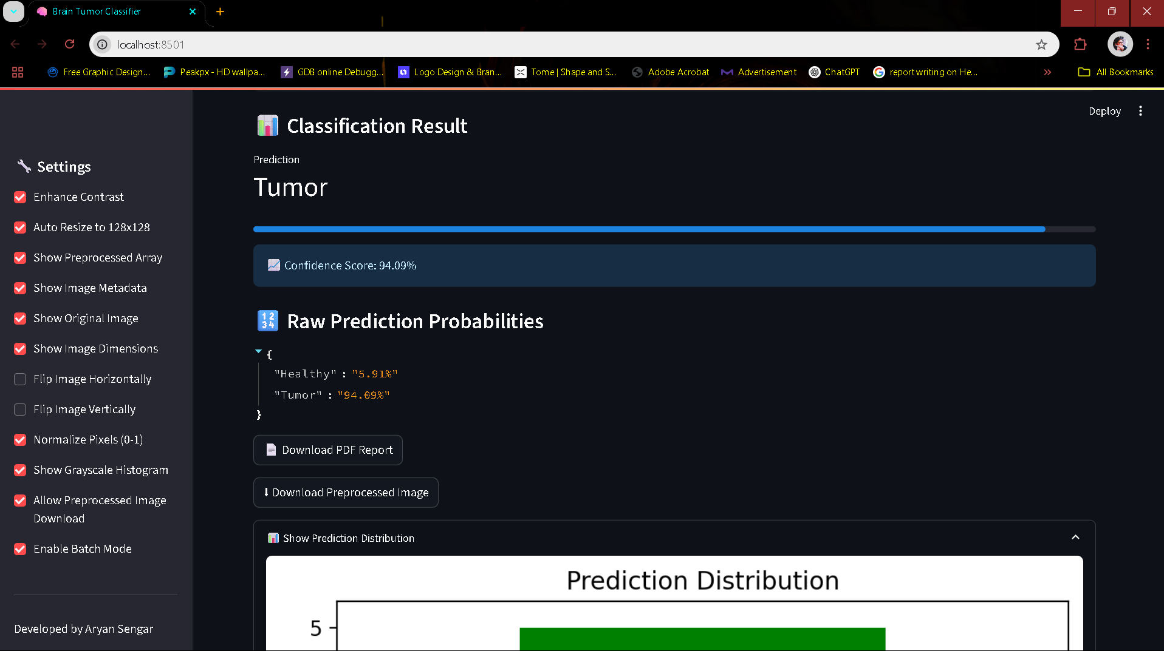
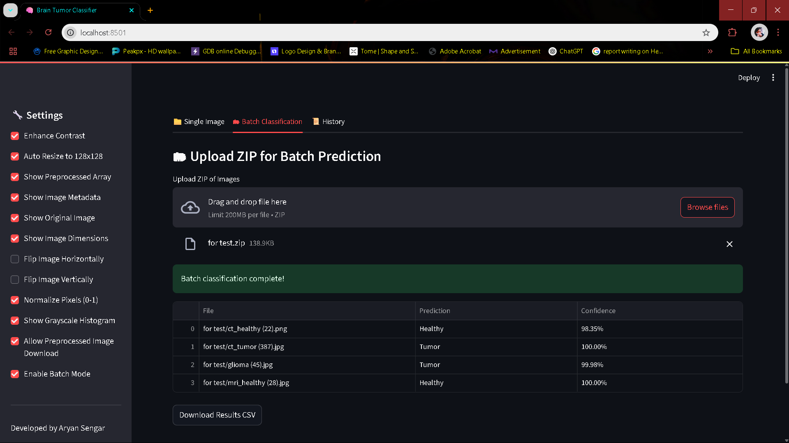
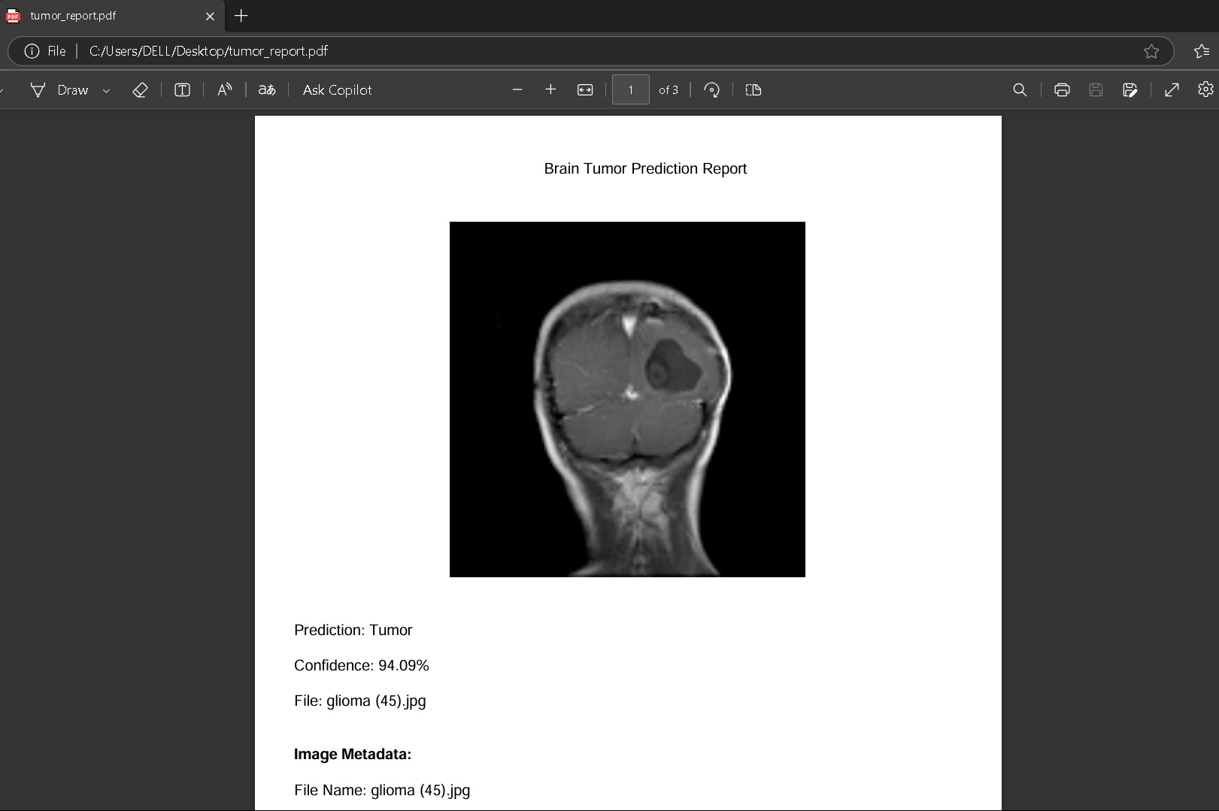
Minimum Viable Product (MVP):

Slide 10
Future Enhancements:
Multi-class tumor detection (glioma, meningioma, pituitary)
DICOM image support
Grad-CAM heatmap explainability
Cloud deployment (Vertex AI / Streamlit Cloud)
Patient data & database integration
Project Links:
GitHub Repository: https://github.com/aryansengar007/brain-tumor-classifier
Demo Video: https://drive.google.com/file/d/1bTZAPYUFGMByg1zFmahwQTzttGkAHAyT/view?usp=sharing
MVP Link: Local Streamlit Application

Slide 11
Thank You
22

